Slide 1
Unit II
Introduction to data mining

Slide 2
Data Mining
The process of extracting information to identify patterns, trends, and useful data that would allow the
business to take the data-driven decision from huge sets of data is called Data Mining.
Data Mining is the process of investigating hidden patterns of information to various perspectives for categorization into useful data, which is collected and assembled in particular areas such as data warehouses, efficient analysis, data mining algorithm, helping decision making and other data requirement to eventually cost-cutting and generating revenue.

Slide 3
Data mining is the act of automatically searching for large stores of information to find trends and patterns that go beyond simple analysis procedures.
Data mining utilizes complex mathematical algorithms for data segments and evaluates the probability of future events. Data Mining is also called Knowledge Discovery of Data (KDD).
The biggest challenge is to analyze the data to extract important information that can be used to solve a problem or for company development. There are many powerful instruments and techniques available to mine data and find better insight from it.

Slide 4
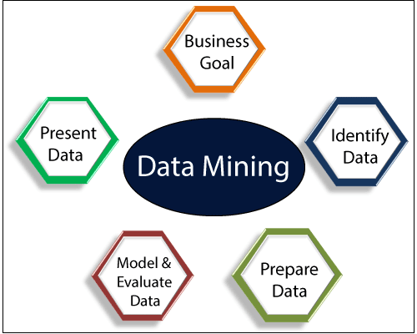

Slide 5
Types of Data Mining
Data mining can be performed on the following types of data:
Relational Database:
A relational database is a collection of multiple data sets formally organized by tables, records, and columns from which data can be accessed in various ways without having to recognize the database tables.
Tables convey and share information, which facilitates data searchability, reporting, and organization.

Slide 6
Data warehouses
A Data Warehouse is the technology that collects the data from various sources within the organization to provide meaningful business insights.
The huge amount of data comes from multiple places such as Marketing and Finance. The extracted data is utilized for analytical purposes and helps in decision- making for a business organization.
The data warehouse is designed for the analysis of data rather than transaction processing.

Slide 7
Data Repositories
The Data Repository generally refers to a destination for data storage. However, many IT professionals utilize the term more clearly to refer to a specific kind of setup within an IT structure. For example, a group of databases, where an organization has kept various kinds of information.
Object-Relational Database
A combination of an object-oriented database model and relational database model is called an object-relational model. It supports Classes, Objects, Inheritance, etc.

Slide 8
Transactional Database
A transactional database refers to a database management system (DBMS) that has the potential to undo a database transaction if it is not performed appropriately.
Even though this was a unique capability a very long while back, today, most of the relational database systems support transactional database activities.

Slide 9
Advantages of Data Mining
The Data Mining technique enables organizations to obtain knowledge-based data.
Data mining enables organizations to make lucrative modifications in operation and production.
Compared with other statistical data applications, data mining is a cost-efficient.
Data Mining helps the decision-making process of an organization.
It Facilitates the automated discovery of hidden patterns as well as the prediction of trends and behaviors.
It can be induced in the new system as well as the existing platforms.
It is a quick process that makes it easy for new users to analyze enormous amounts of data in a short time.

Slide 10
Disadvantages of Data Mining
There is a probability that the organizations may sell useful data of customers to other organizations for money. As per the report, American Express has sold credit card purchases of their customers to other organizations.
Many data mining analytics software is difficult to operate and needs advance training to work on.
Different data mining instruments operate in distinct ways due to the different algorithms used in their design. Therefore, the selection of the right data mining tools is a very challenging task.
The data mining techniques are not precise, so that it may lead to severe consequences in certain conditions.

Slide 11
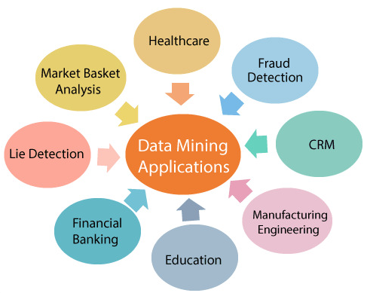
Data Mining Applications

